Slide 1
Library booking system
ZHANG YANCHENG 11537668
ZHANG HAOYU 11534357
GUO LINGHAO 11537735

Slide 2
MENU
Actual problems
& our idea
Project structure
Selenium part
Main part
How we cooperate

Slide 3
Actual problems
Our library’s website is
REALLY HARD TO USE
It is AWKWARD if you take the seat others booked
Choose a serious of time slot is time-wasting

Slide 4
What if ……
The procedure can be simplified
Can book all the time slot in one run
Check-in automatically

Slide 5
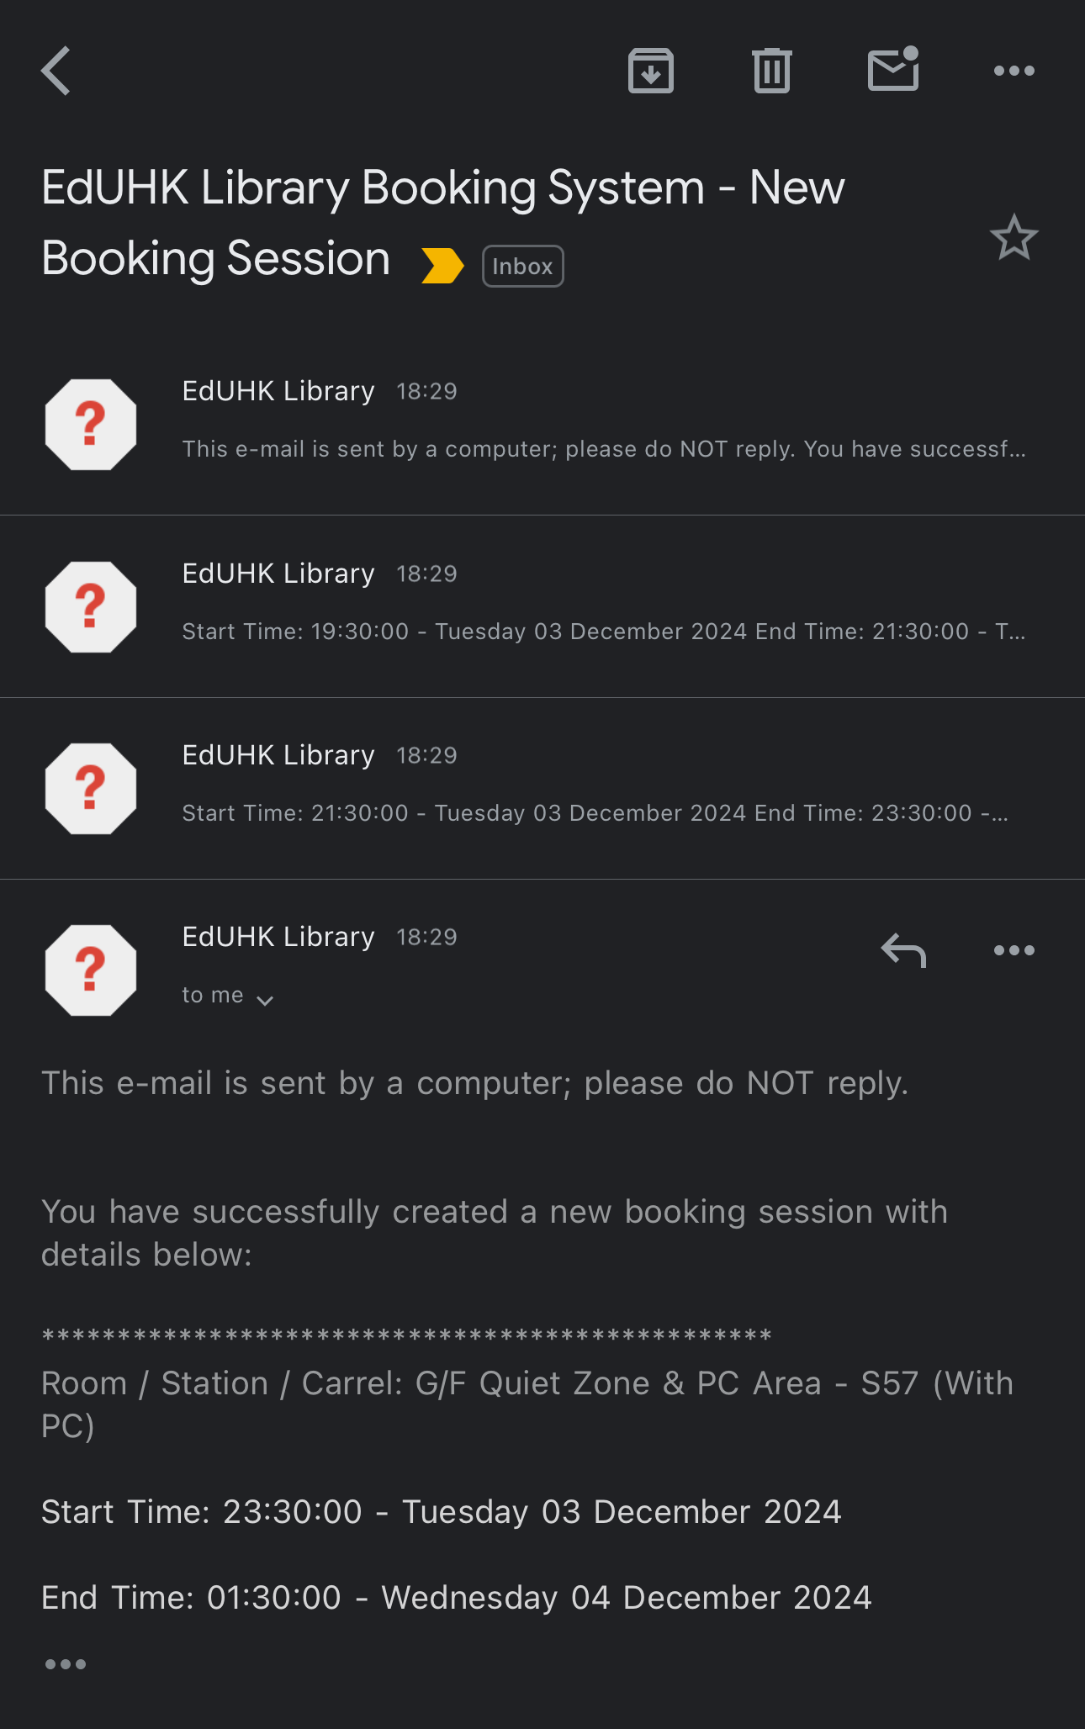
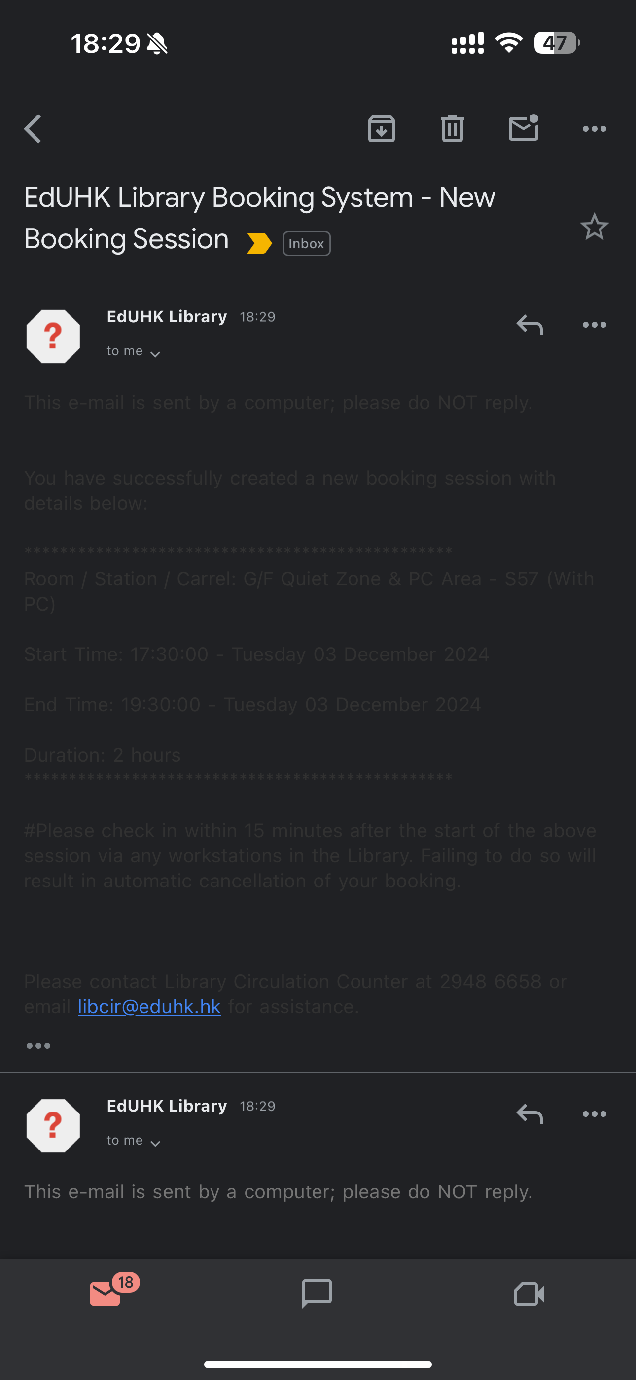
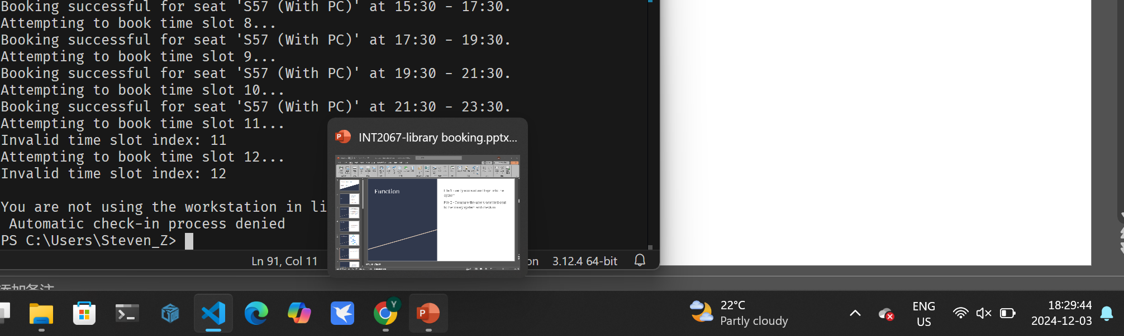
Test cases

Slide 6
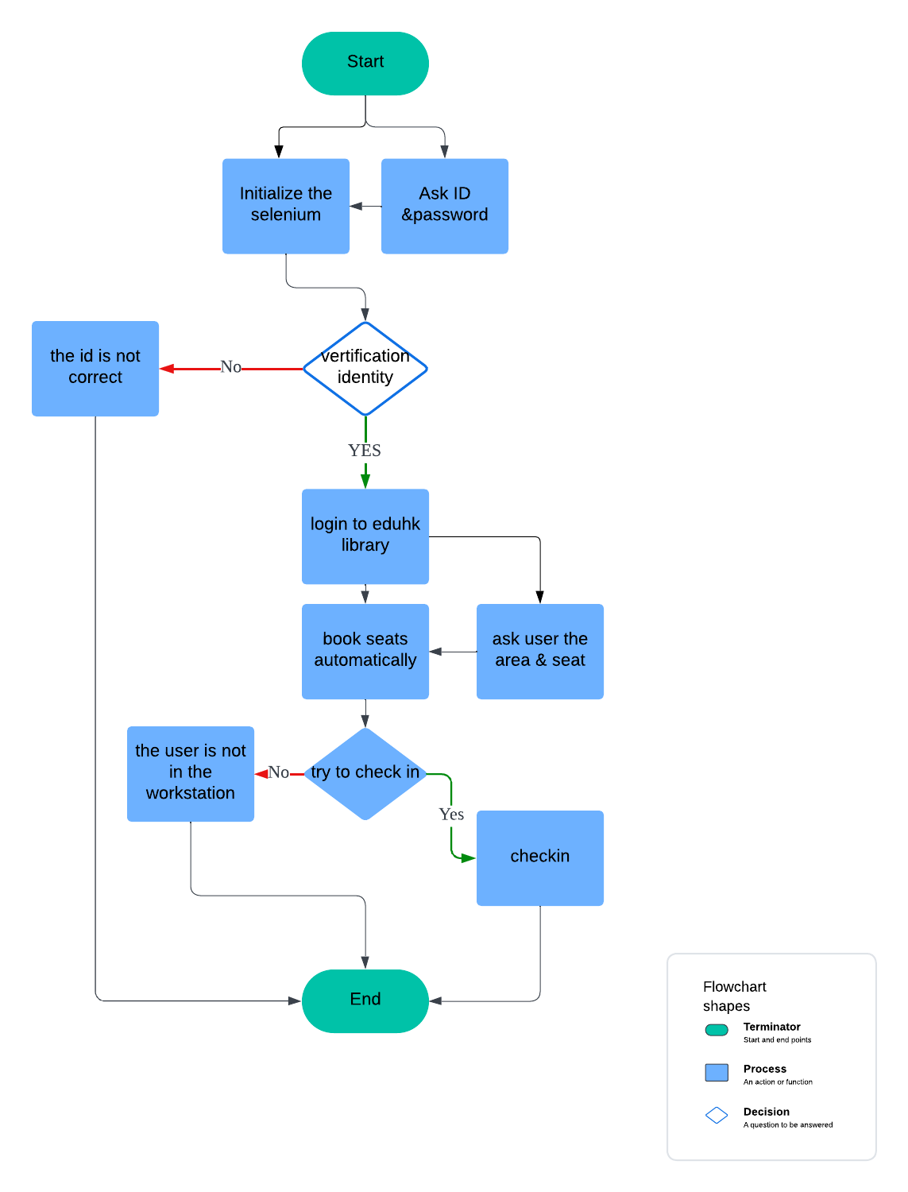
Project Structure
Ask user to type ID and Password
Verify the account
Login into library system
User type the seat number or computer suggest some available seats for user
Check in

Slide 7
Function
File 1 - verify account and login into the system
File 2 - Compare the user’s selected seat to the library system and check in

Slide 8

Selenium Part
A powerful automation tool
Actually, it is the “PLAN B”

Slide 9
Develop history
Learn basic html, css & javascript
Try to use the “request” library
Still can not login
Still can not work ; )
Can not successfully log in website
Start to learn cookie & session
Get to know the “Method ” when surfing the internet
& tried to use different methods in request

Slide 10
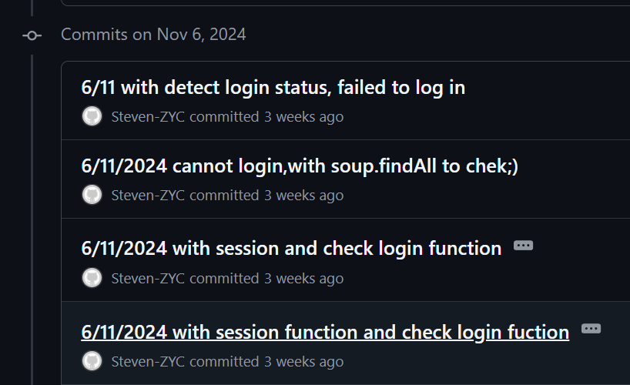
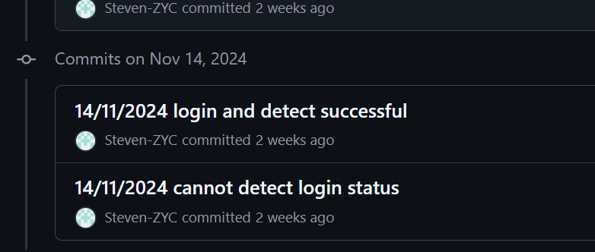
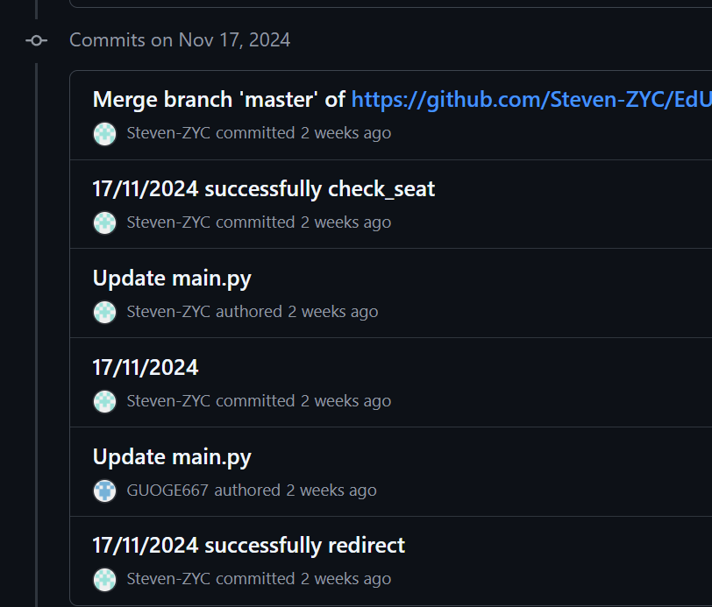
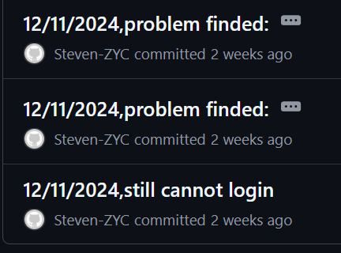
It is a really tough journey

Slide 11
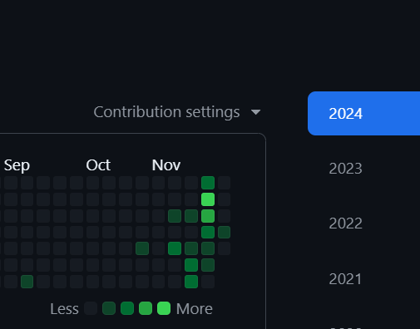
After hundreds of fails,
My commits history of this project, really tough
I finally turned to the selenium :)
AND IT WORKED!

Slide 12
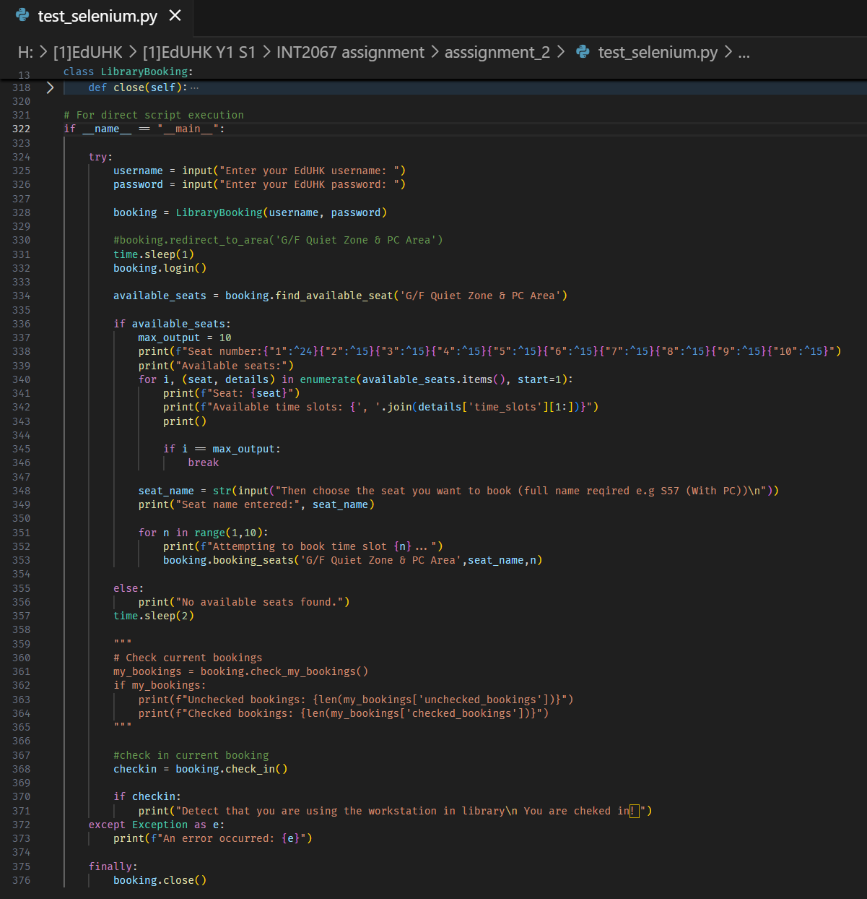
“Try” syntax
After mountains of debugs……

Slide 13
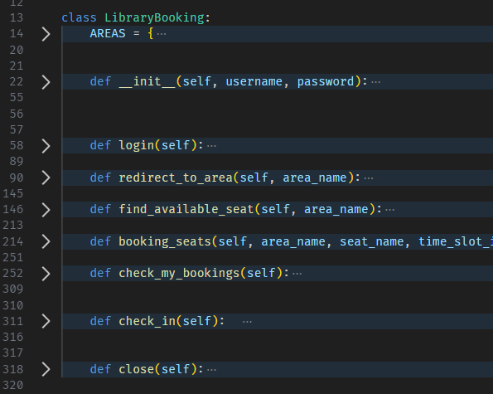
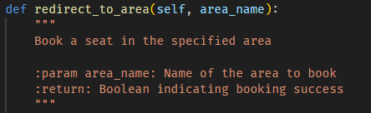
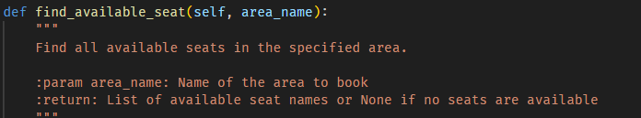
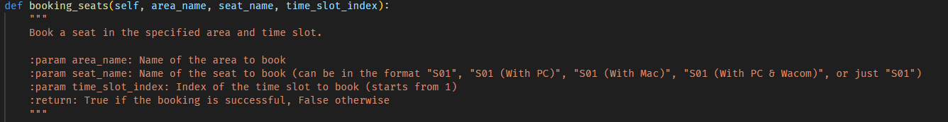
Capsulation
Use OOP to encapsulate my code, make it easy for team cooperation
Follow the notion of “Don’t repeat yourself(DRY)”

Slide 14
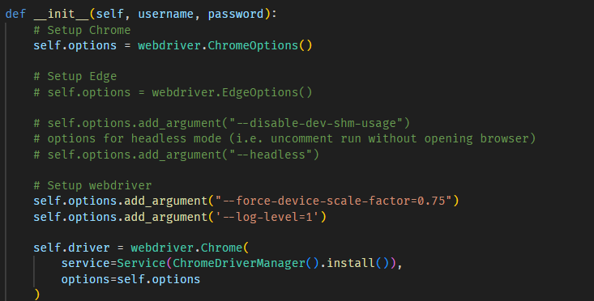

Wide Compatibility
In case some computer do not have chrome
Users even do not need to install webdriver

Slide 15
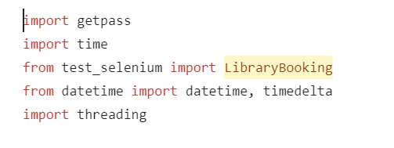
Main part
These imports make it easy for selenium to perform web manipulation and multithreading in conjunction with time

Slide 16
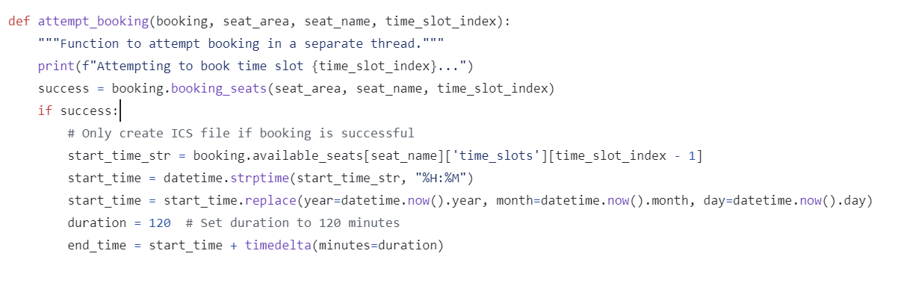
As a whole, the function of this code is to attempt to reserve a seat and generate the appropriate calendar event file when successful.

Slide 17
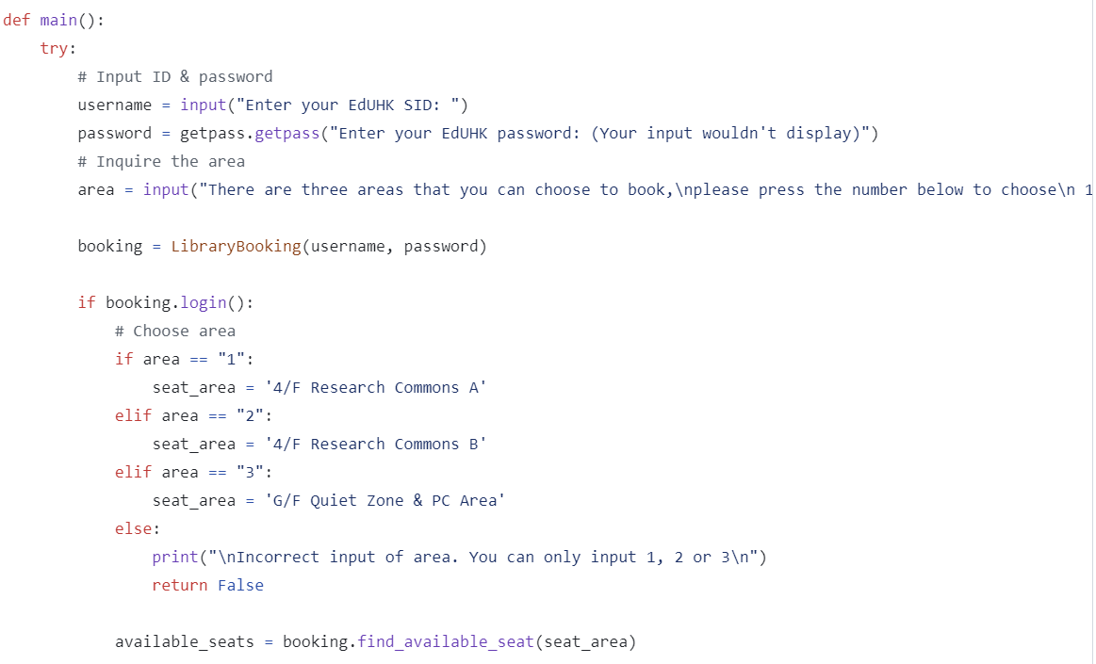
Getting user input
implement the user login and selection of an appointment area.
If no,give an appropriate prompt.

Slide 18
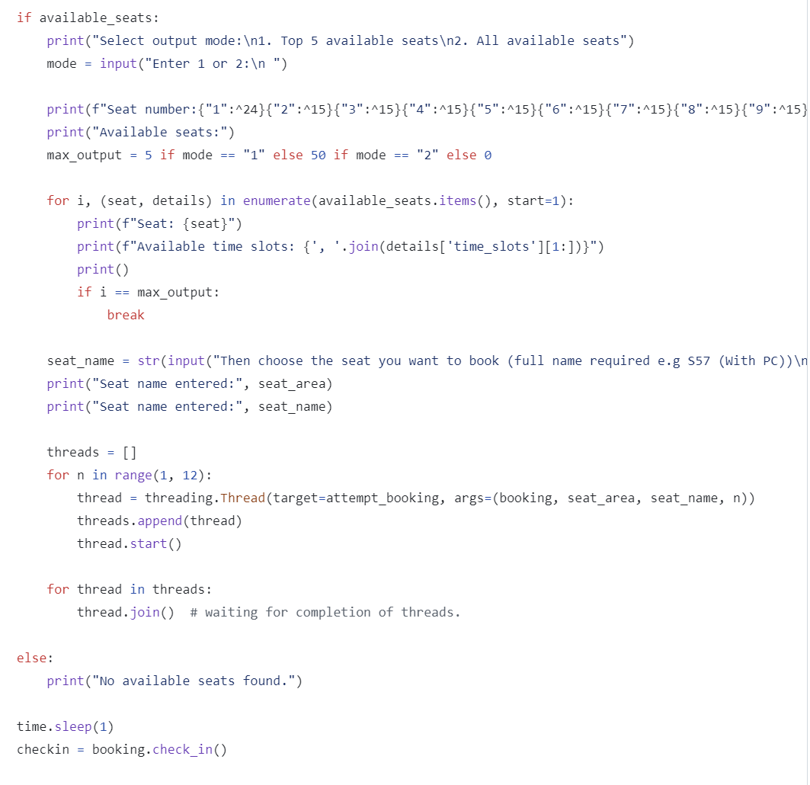
LOGIC
The function of this code is to display the available seats, allow the user to select a seat for reservation and process the reservation request through multithreading.It also handles the case where there are no available seats.

Slide 19

HOW
WE
COOPERATE
Git
Class
GitHub
Encapsulation
Image Source

Slide 20

THANKS
for your listening

